Slide 1
Project Update 3.0

Slide 4
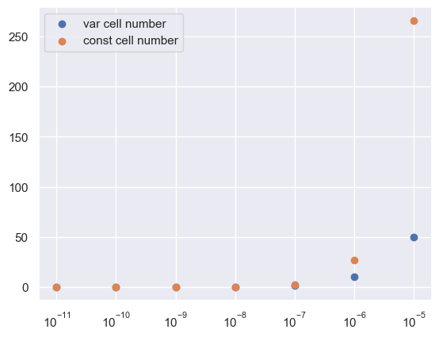

Slide 5
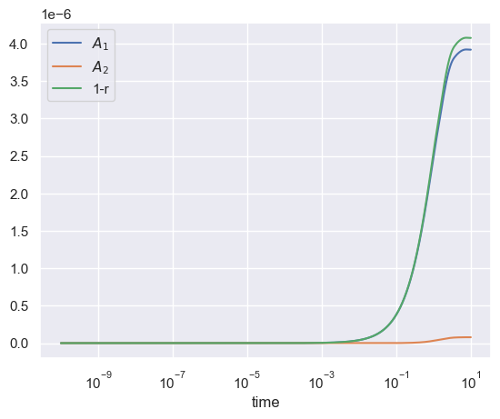
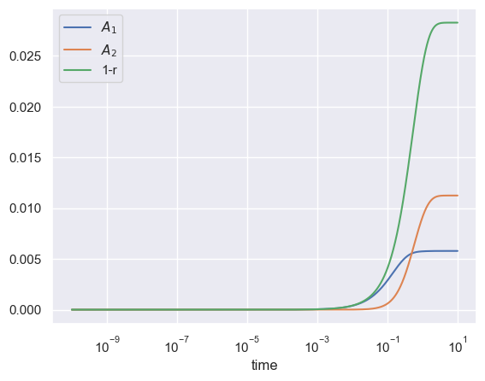
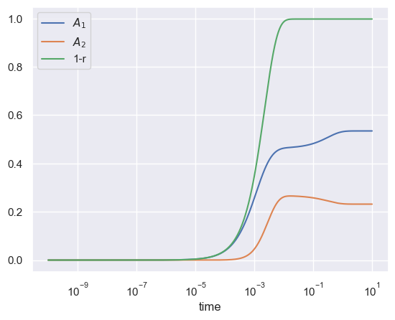
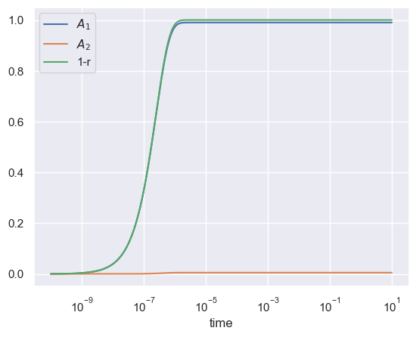
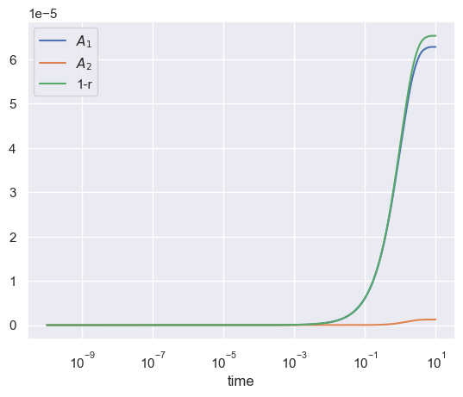
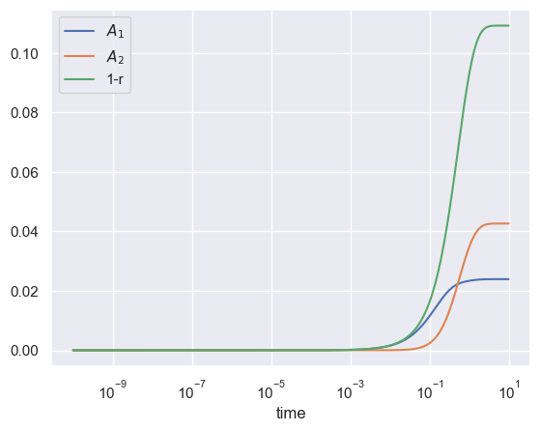
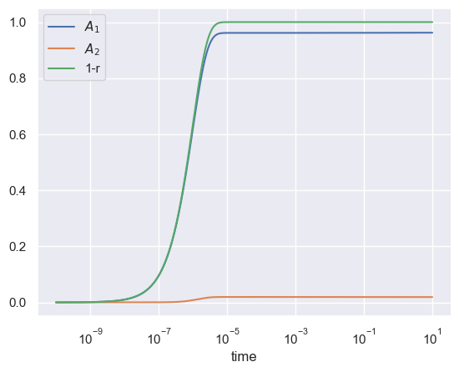

Slide 6
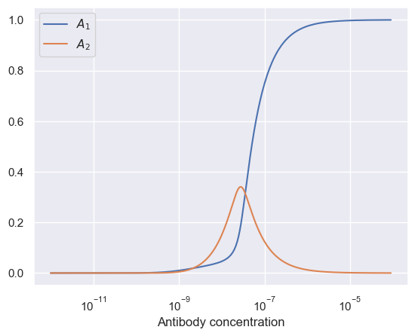
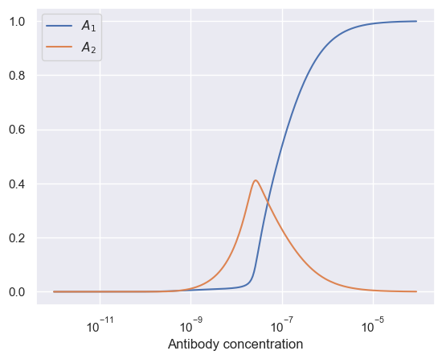
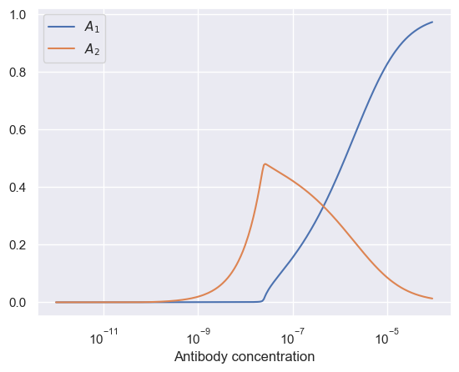

Slide 7
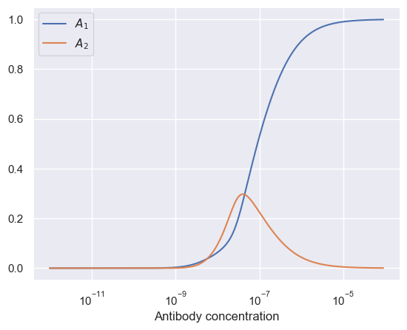
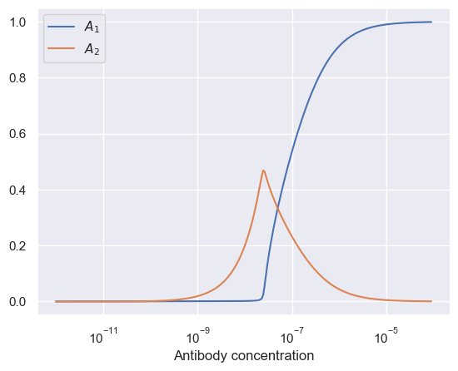

Slide 9
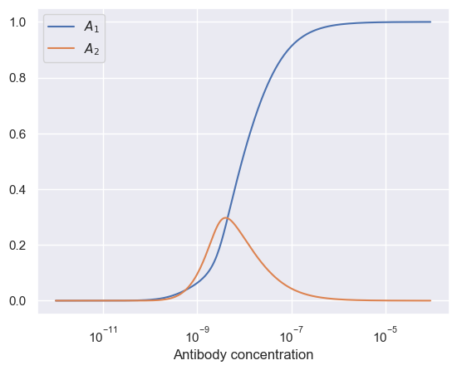
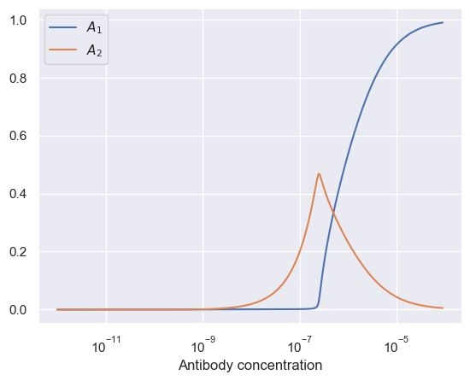

Slide 10
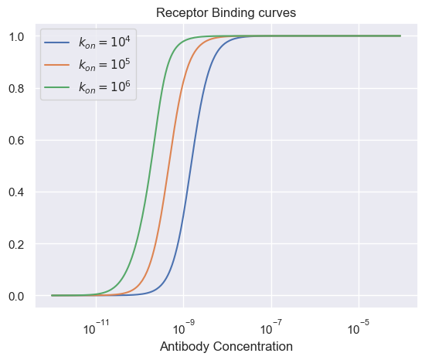
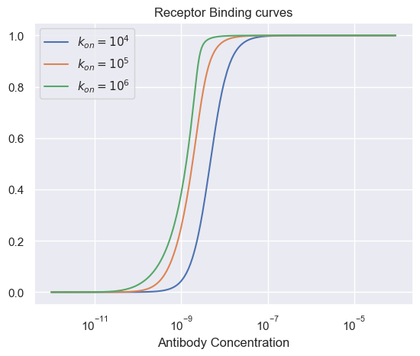
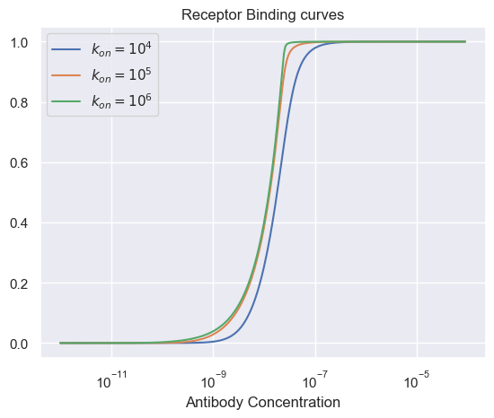

Slide 11
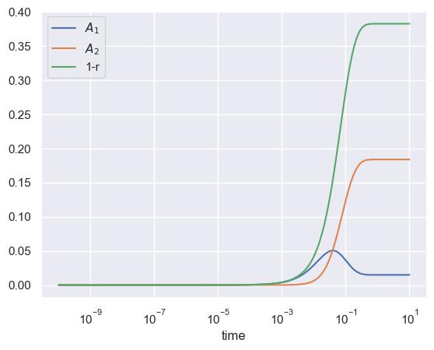
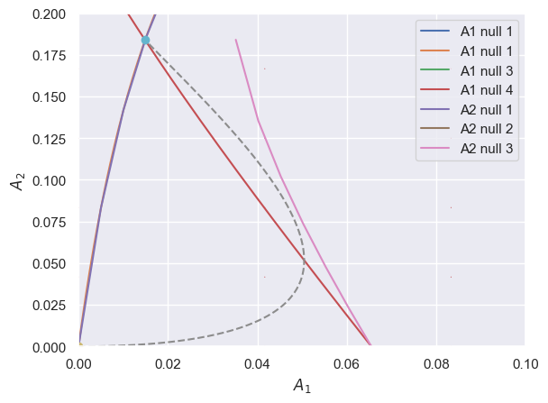

Slide 12
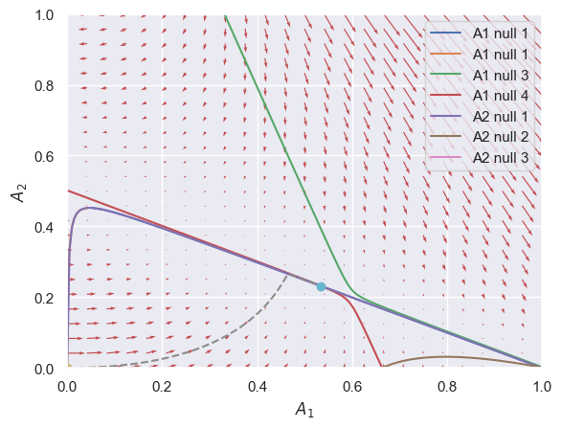
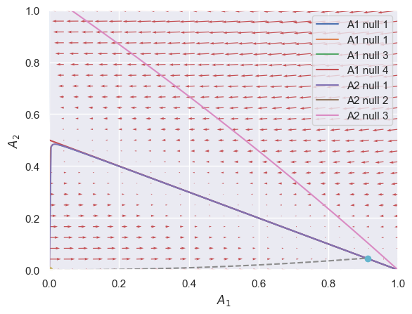
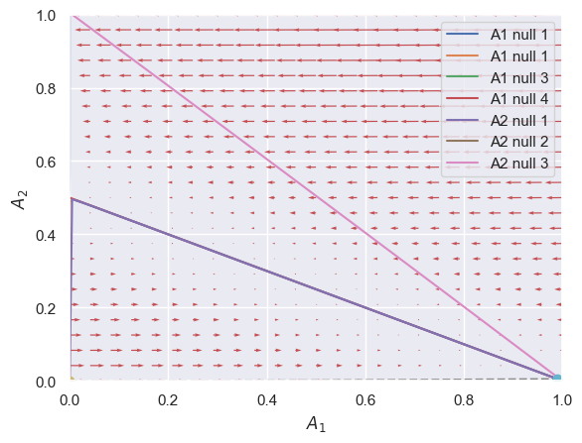

Slide 14




Slide 15



Slide 16
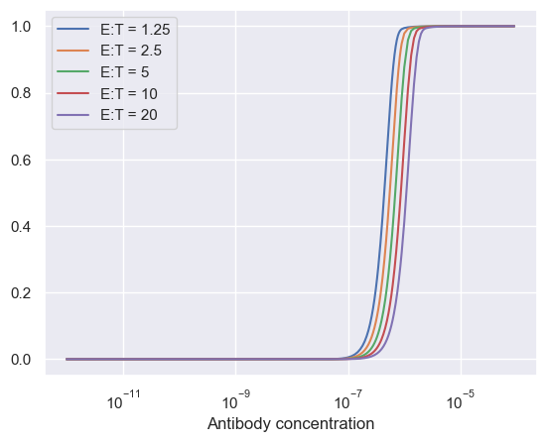



Slide 17







Slide 18
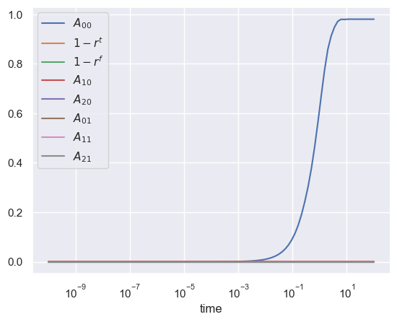

Slide 19
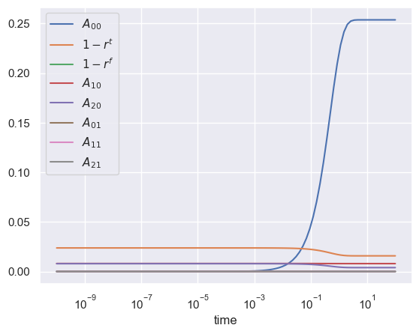


Slide 20
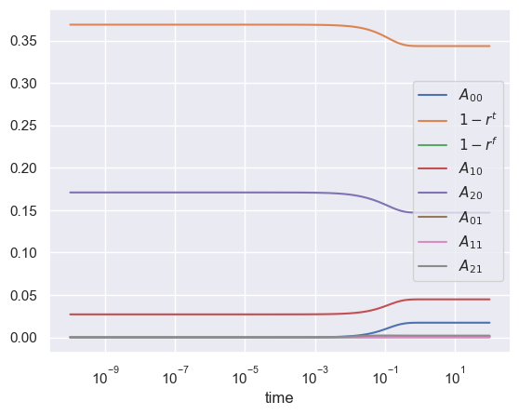


Slide 21
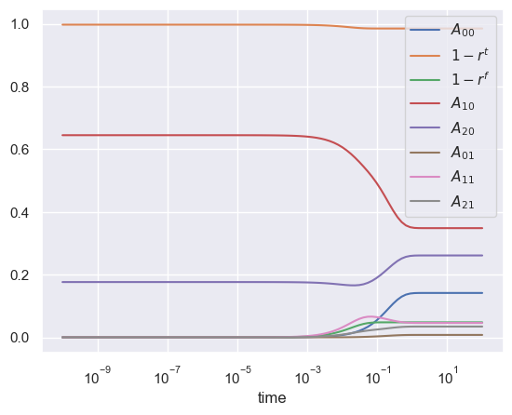
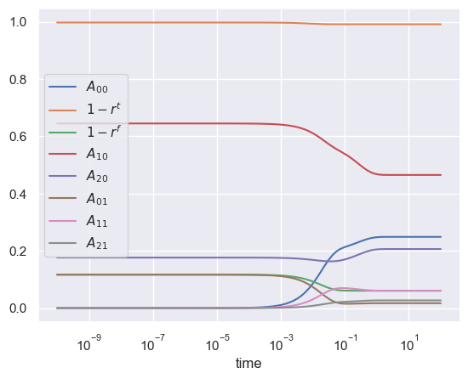

Slide 22
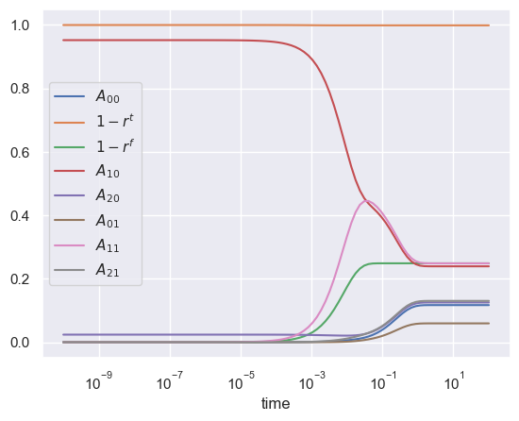
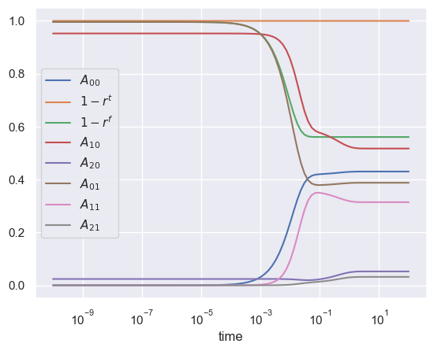

Slide 23
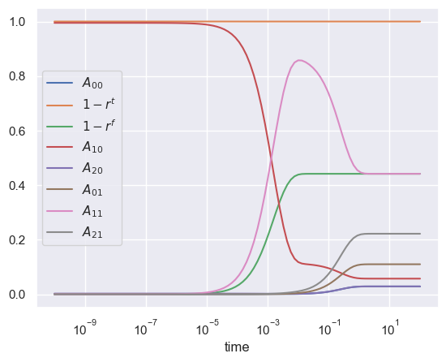
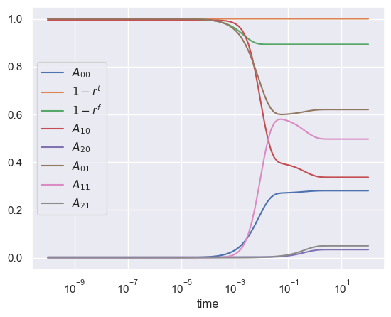

Slide 24
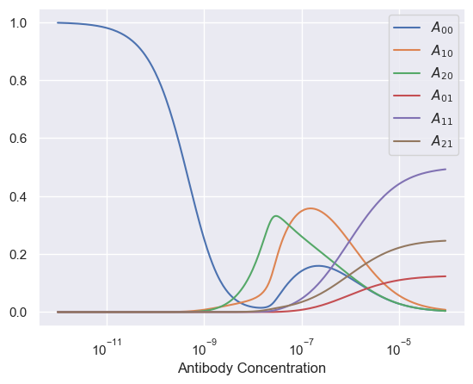
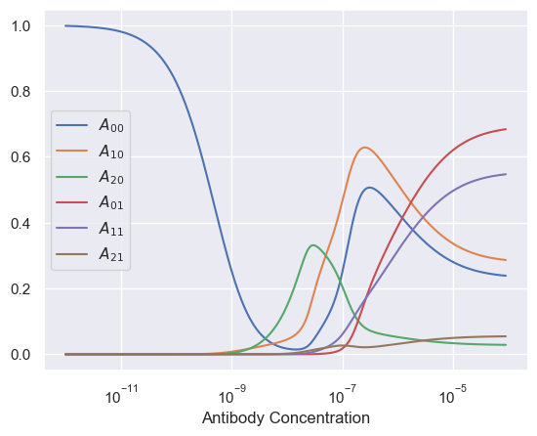

Slide 25
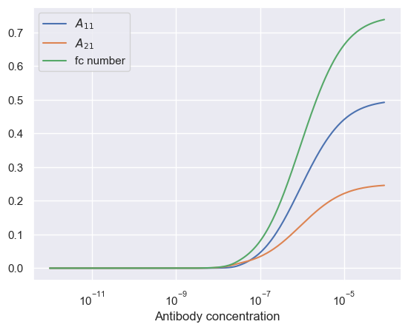
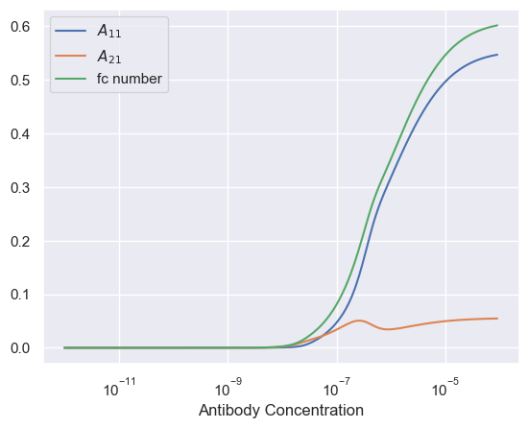

Slide 26
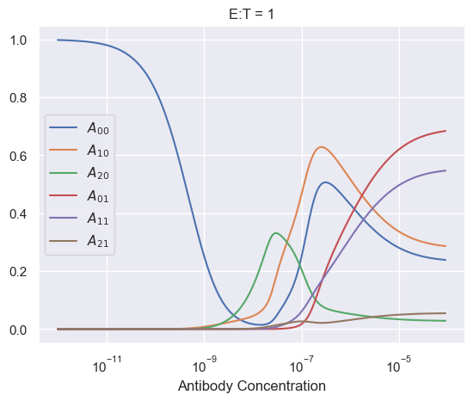
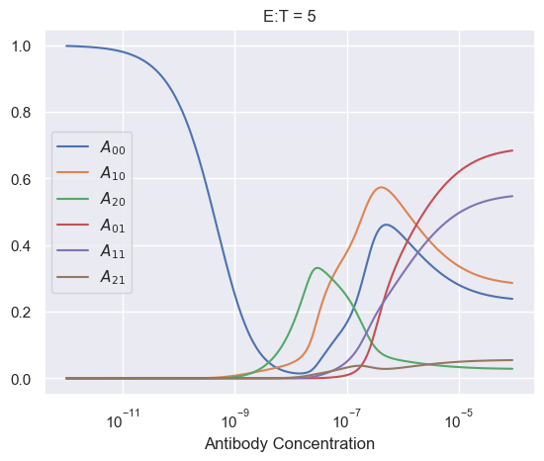
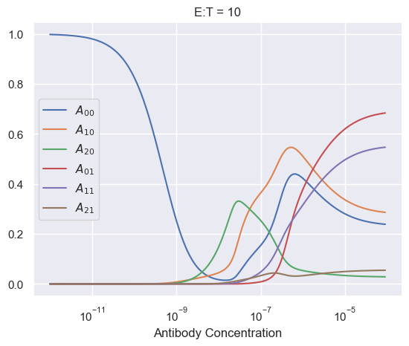
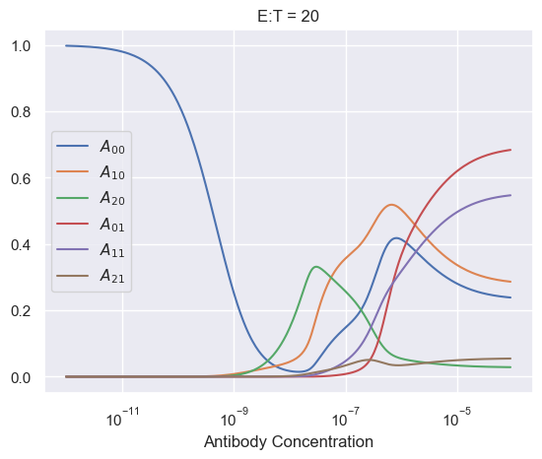

Slide 27
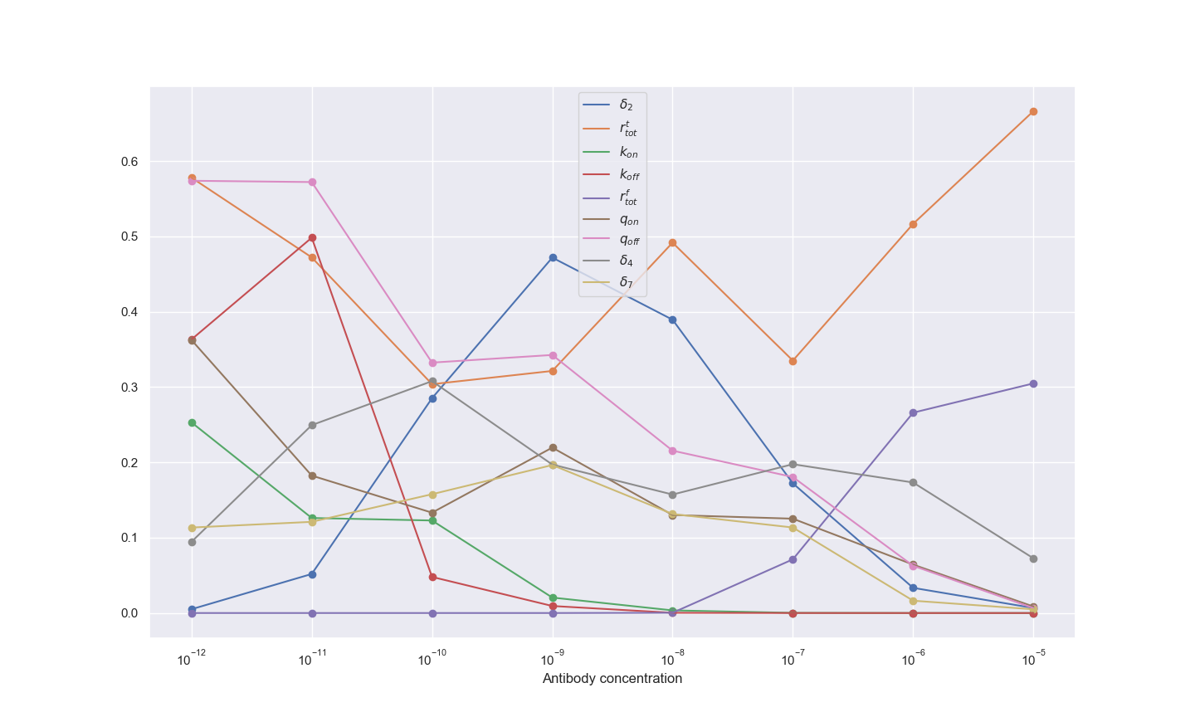
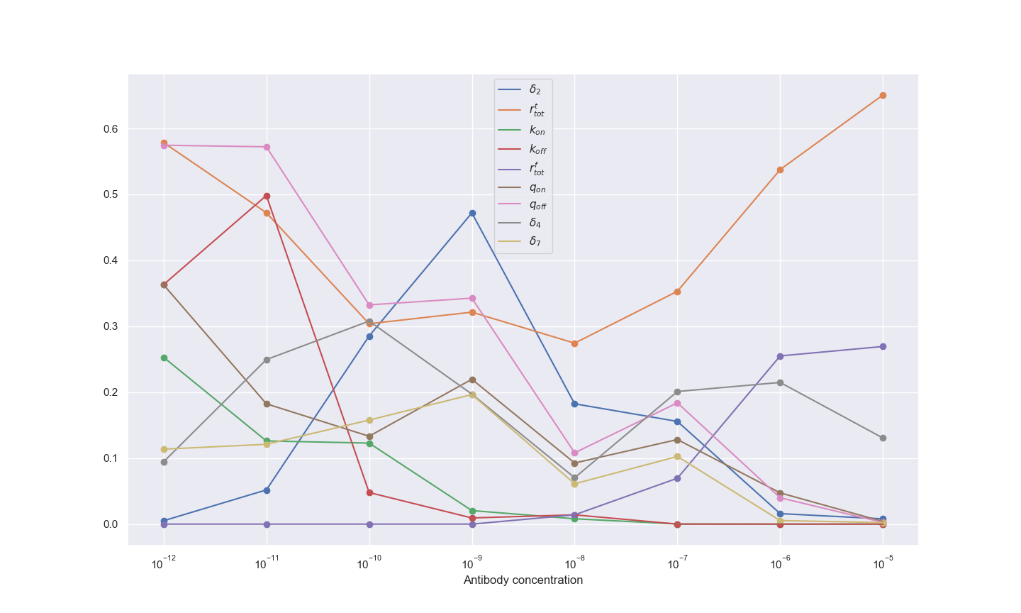
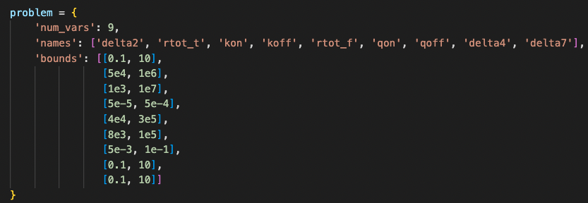

Slide 29
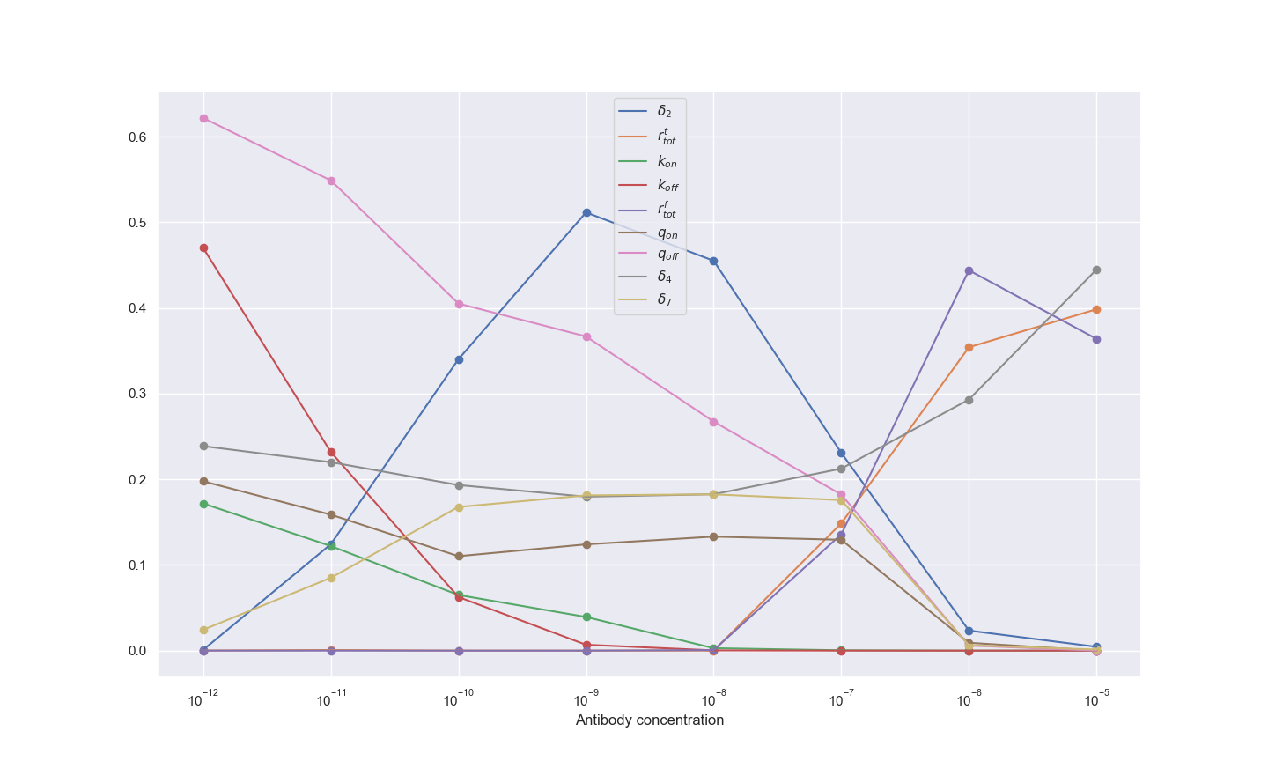

Slide 30
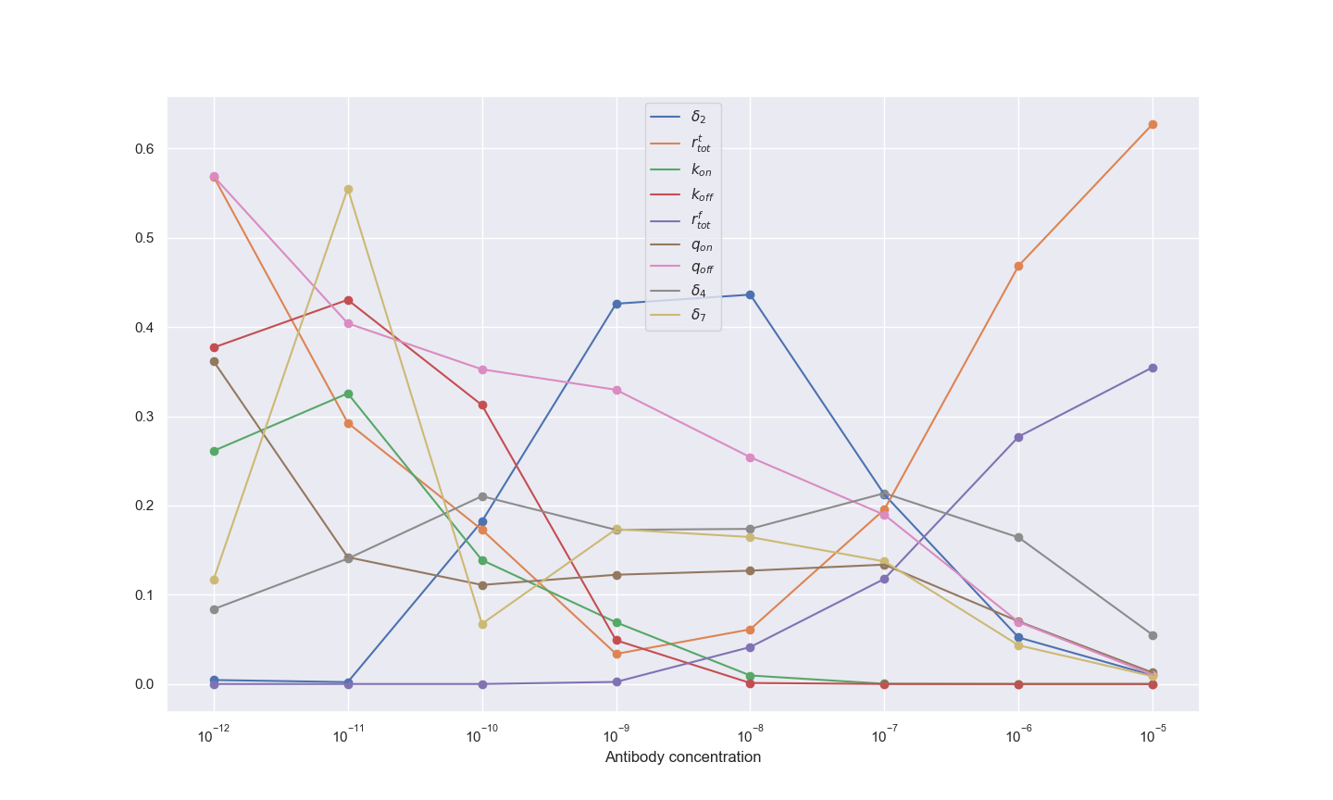

Slide 31
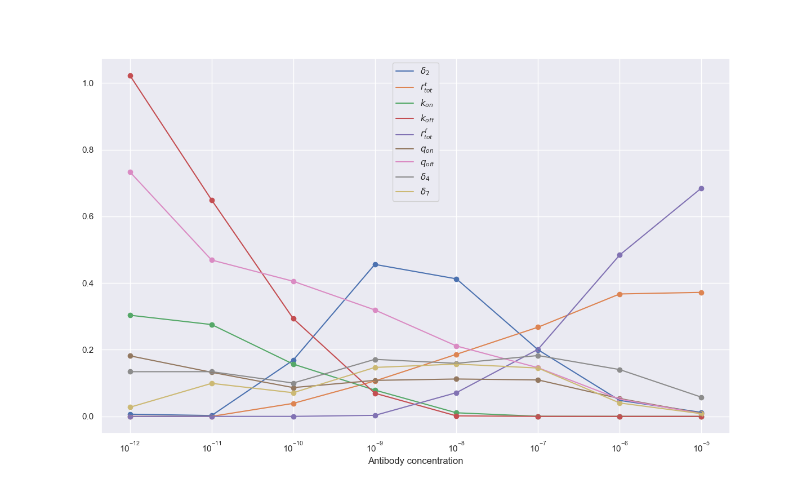

Slide 33
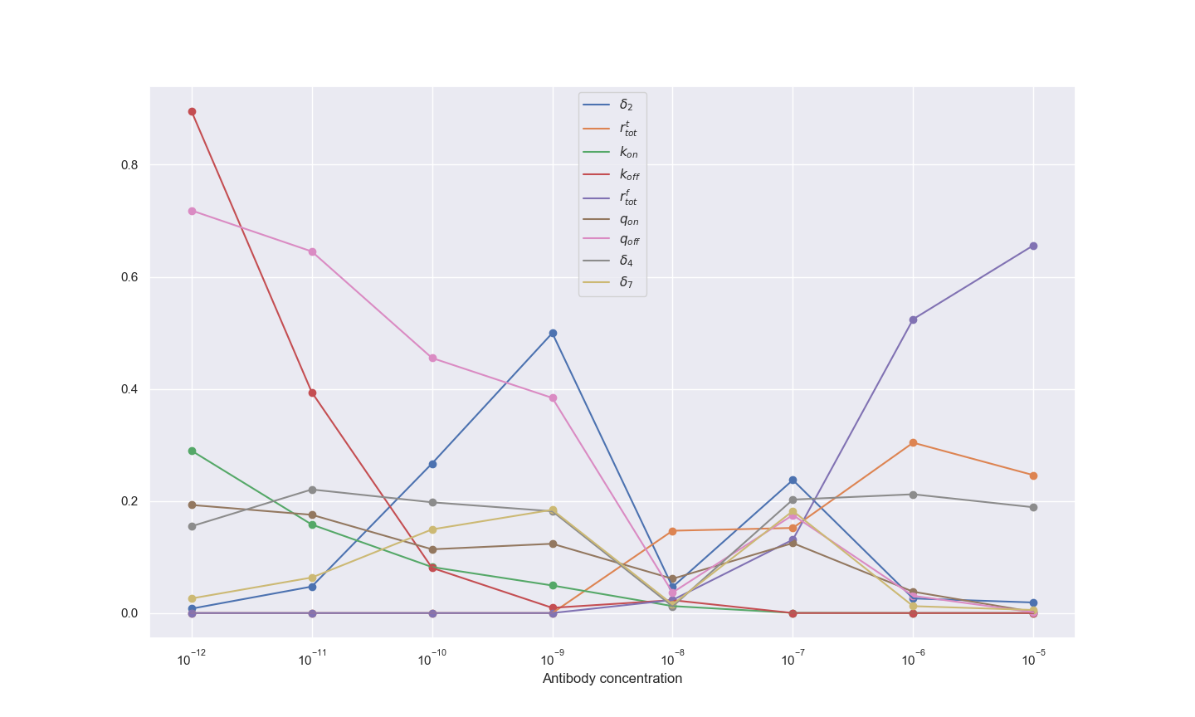

Slide 34
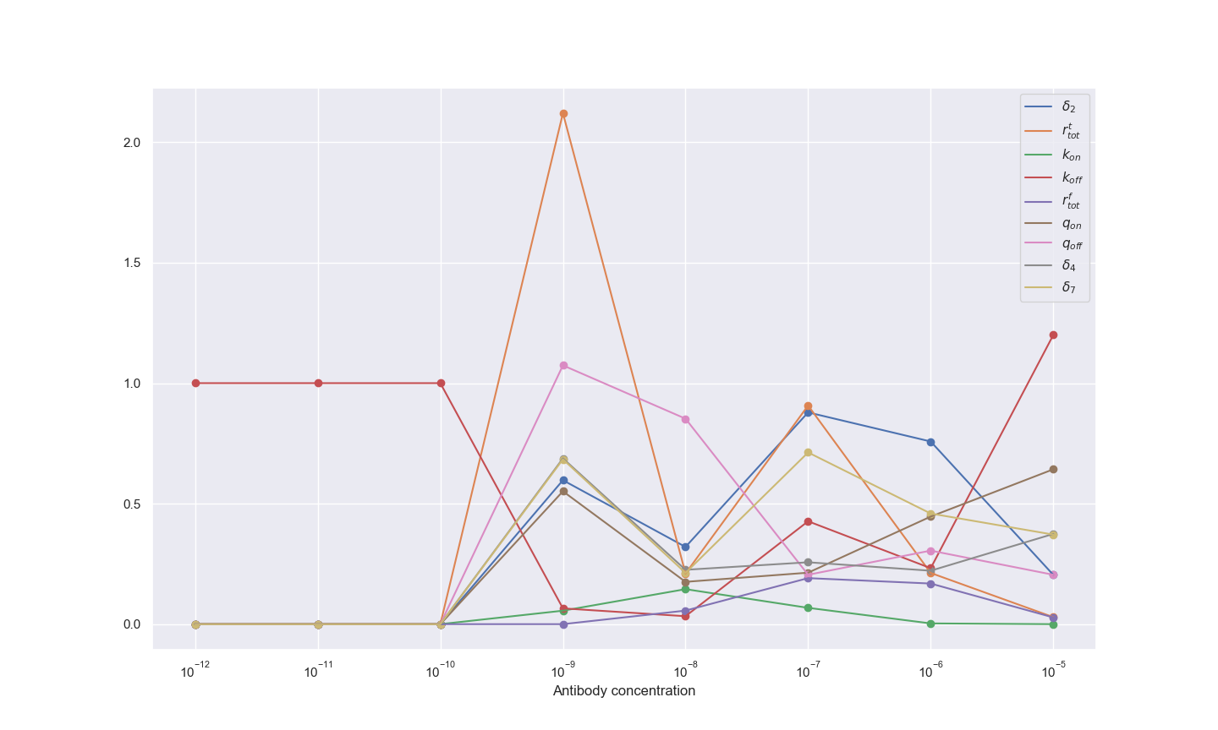

Slide 35
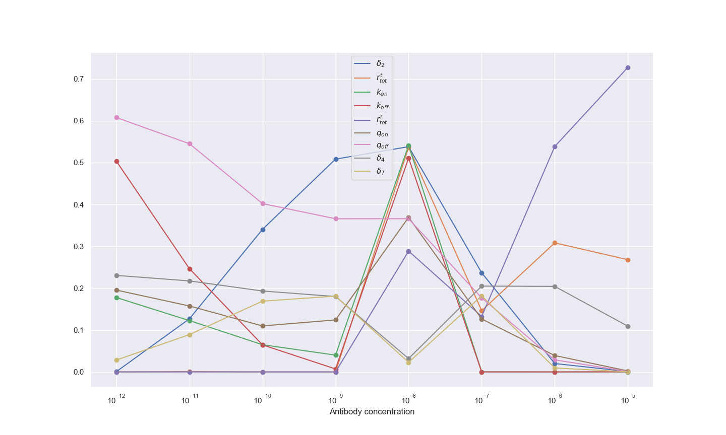

Slide 36



Slide 37



Slide 38



Slide 39



Slide 41



Slide 42



Slide 43
Case 1 sensitive parameters
Antibody concentration range | Steady state fc percentage bound | Steady state Fc number | Steady state Fc number with recycling | Steady state fc percentage bound with recycling | Max fc number | Max fc percentage bound | Max fc number with recycling
10^-12 – 10^-10 (low Ab conc) | Target receptor number, target and fc dissociation rates, target association rate | Target and fc dissociation rates | Target and fc dissociation rates, target binding rate, target association rate | Target receptor number, target and fc dissociation rates, bivalent bound ab fc binding rate (A20->A21) | Target dissociation rate | Target dissociation rate
10^-10 – 10^-7 (middle Ab conc) | Target crosslinking, target receptor number, fc dissociation rate | Target crosslinking, fc dissociation rate | Target crosslinking, fc dissociation rate | Target crosslinking, fc dissociation rate | Fc dissociation rate, target receptor number | Fc dissociation rate, target receptor number
10^-7-10^-5 (high Ab conc) | Monovalent bound Ab fc binding rate (A10-> A11), fc and target receptor number | Monovalent bound Ab fc binding rate (A10-> A11), fc receptor number, target receptor number | Monovalent bound Ab fc binding rate (A10-> A11), fc receptor number, target receptor number | Monovalent bound Ab fc binding rate (A10-> A11), fc and target receptor numbers | Monovalent bound Ab fc binding rate (A10-> A11), target dissociation rate | Monovalent bound Ab fc binding rate (A10-> A11), target dissociation rate

Slide 44




Slide 45




Slide 46



Slide 47




Slide 48




Slide 49



Slide 50








Slide 51



Slide 52


Slide 55


Slide 57






Slide 58



Slide 60





Slide 61


Slide 62




Slide 63




Slide 64




Slide 65



Slide 66



Slide 67


Slide 68



Slide 69


Slide 70


